Slide 1
INPUT/OUTPUT HANDLING
The user need not know how peripheral devices work. Os handles the devices on behalf of the user

Slide 2
Pillars of a computer System
The four pillars on which a computer stands include
CPU
Memory
I/O subsystem
Filling System
The I/O subsystem is the most complicated. Reason – the wide variety of I/O devices

Slide 3
Categories of I/O Devices
External devices that engage in I/O with computer systems can be grouped into three categories:
Human readable
Machine readable
Communication
suitable for communicating with the computer user
printers, terminals, video display, keyboard, mouse
suitable for communicating with electronic equipment
disk drives, USB keys, sensors, controllers
suitable for communicating with remote devices
modems, digital line drivers
Notes:
As was mentioned in Chapter 1 , external devices that engage in I/O with computer
systems can be roughly grouped into three categories:
• Human readable: Suitable for communicating with the computer user.
Examples include printers and terminals, the latter consisting of video display,
keyboard, and perhaps other devices such as a mouse.
Machine readable: Suitable for communicating with electronic equipment.
Examples are disk drives, USB keys, sensors, controllers, and actuators.
• Communication: Suitable for communicating with remote devices. Examples
are digital line drivers and modems.

Slide 4
Differences in I/O Devices
Devices differ in a number of areas:
Data Rate
there may be differences of magnitude between the data transfer rates
Application
the use to which a device is put has an influence on the software
Unit of Transfer
data may be transferred as a stream of bytes or characters or in larger blocks
Data Representation
different data encoding schemes are used by different devices
Error Conditions
the nature of errors, the way in which they are reported, their consequences, and the available range of responses differs from one device to another
Notes:
There are great differences across classes and even substantial differences
within each class. Among the key differences are the following:
• Data rate: There may be differences of several orders of magnitude between
the data transfer rates. Figure 11.1 gives some examples.
• Application: The use to which a device is put has an influence on the software
and policies in the operating system and supporting utilities. For example, a
disk used for files requires the support of file management software. A disk
used as a backing store for pages in a virtual memory scheme depends on the
use of virtual memory hardware and software. Furthermore, these applications
have an impact on disk scheduling algorithms (discussed later in this
chapter). As another example, a terminal may be used by an ordinary user or a
system administrator. These uses imply different privilege levels and perhaps
different priorities in the operating system.
• Complexity of control: A printer requires a relatively simple control interface.
A disk is much more complex. The effect of these differences on the operating
system is filtered to some extent by the complexity of the I/O module that
controls the device, as discussed in the next section.
Unit of transfer: Data may be transferred as a stream of bytes or characters
(e.g., terminal I/O) or in larger blocks (e.g., disk I/O).
• Data representation: Different data encoding schemes are used by different
devices, including differences in character code and parity conventions.
• Error conditions: The nature of errors, the way in which they are reported,
their consequences, and the available range of responses differ widely from
one device to another.
This diversity makes a uniform and consistent approach to I/O, both from the
point of view of the operating system and from the point of view of user processes,
difficult to achieve.

Slide 5
Design Objectives of OS
How is the OS designed to cope with the wide variety of devices
Character code independence
Device independence
Efficiency
Uniform treatment of devices

Slide 6
Character Code Independence
Data representation varies in different peripheral devices
Standard OS character code independent of any particular device used to represent data internally.
A translational mechanism used to convert data to device specific format

Slide 7
Device Independence
User programs should be independent from the devices they operate on.
programs can access any I/O device without specifying device in advance (floppy, hard drive, or CD-ROM)
Leads to an organization of the operating system into a series of layers
Each layer performs a related subset of the functions required of the operating system
Layers should be defined so that changes in one layer do not require changes in other layers
Notes:
In Chapter 2 , in the discussion of system structure, we emphasized the hierarchical
nature of modern operating systems. The hierarchical philosophy is that the functions
of the operating system should be separated according to their complexity,
their characteristic time scale, and their level of abstraction. Following this approach
leads to an organization of the operating system into a series of layers. Each layer
performs a related subset of the functions required of the operating system. It relies
on the next lower layer to perform more primitive functions and to conceal the
details of those functions. It provides services to the next higher layer. Ideally, the
layers should be defined so that changes in one layer do not require changes in other
layers. Thus we have decomposed one problem into a number of more manageable
subproblems.
In general, lower layers deal with a far shorter time scale. Some parts of the
OS must interact directly with the computer hardware, where events can have a
time scale as brief as a few billionths of a second. At the other end of the spectrum,
parts of the operating system communicate with the user, who issues commands at a
much more leisurely pace, perhaps one every few seconds. The use of a set of layers
conforms nicely to this environment.

Slide 8
OS Layers – How is device independence achieved in OS?
Application Programs
i/o control system (s/w)
Device Drivers(s/w)
Device Controllers(H/w)
Device(H/w)

Slide 9
Application Programs – Within the application, I/O activity is expressed in user oriented terms. Print, save, open etc. System calls are made which invoke OS functions.
I/O control system – part of os which deals with I/O related system calls. Performs the initial processing and validation on the request and routes it to the appropriate handler.

Slide 10
Device drivers – Is a software module which manages the communication with and control of a specific I/O device.
Device Controllers - I/O units typically consist of an electronic component, which often takes the form of a printed circuit card. A device controller is the electronic circuitry, attached to I/O bus of the computer and provides a hardware interface between the computer and the device itself
Device – Actual peripheral device

Slide 11
Efficiency
Major effort in I/O design
Important because I/O operations often form a bottleneck
Most I/O devices are extremely slow compared with main memory and the processor
Block Device – Transmit a set of characters simultaneous
Character device – Transmit one character at a time

Slide 12
Buffering/Spooling
Technique used to remove bottlenecks in the computer system
Fast and slow peripheral devices communicate via a buffer.
Perform input transfers in advance of requests being made and perform output transfers some time after the request is made
Block-oriented device
stores information in blocks that are usually of fixed size
transfers are made one block at a time
possible to reference data by its block number
disks and USB keys are examples
Stream-oriented device
transfers data in and out as a stream of bytes
no block structure
terminals, printers, communications ports, and most other devices
Notes:
The same considerations apply to an output operation. If a block is being
transferred from a user process area directly to an I/O module, then the process is
blocked during the transfer and the process may not be swapped out.
To avoid these overheads and inefficiencies, it is sometimes convenient to
perform input transfers in advance of requests being made and to perform output
transfers some time after the request is made. This technique is known as buffering.
In this section, we look at some of the buffering schemes that are supported by
operating systems to improve the performance of the system.
In discussing the various approaches to buffering, it is sometimes important
to make a distinction between two types of I/O devices: block oriented and stream
oriented. A block-oriented device stores information in blocks that are usually of
fixed size, and transfers are made one block at a time. Generally, it is possible to
reference data by its block number. Disks and USB keys are examples of block oriented
devices. A stream-oriented device transfers data in and out as a stream of
bytes, with no block structure. Terminals, printers, communications ports, mouse
and other pointing devices, and most other devices that are not secondary storage
are stream oriented.

Slide 13
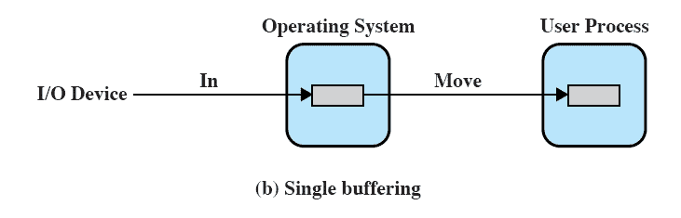
Single Buffer
Operating system assigns a buffer in main memory for an I/O request
Notes:
The simplest type of support that the operating system can provide is single buffering
( Figure 11.5b ). When a user process issues an I/O request, the OS assigns a buffer in
the system portion of main memory to the operation.
In the case of line-at-a-time I/O, the buffer can be used to hold a single line.
The user process is suspended during input, awaiting the arrival of the entire line.
For output, the user process can place a line of output in the buffer and continue
processing. It need not be suspended unless it has a second line of output to send
before the buffer is emptied from the first output operation. In the case of byte-at-a-time
I/O, the interaction between the OS and the user process follows the producer/
consumer model discussed in Chapter 5 .

Slide 14
Uniform Treatment of devices
All devices are handles the same.
Design the I/O system & device routines such that dealing with different devices is done by changing parameters in the routine i.e the routine are very simillar if not identical in structure and operation. Different parameter values make the same routine handle devices differently according to their function.
In unix all devices are regarded as files/streams
Device descriptors store device characteristics

Slide 15
Organization of the I/O Function
Three techniques for performing I/O are:
Programmed I/O
the processor issues an I/O command on behalf of a process to an I/O module; that process then busy waits for the operation to be completed before proceeding
Interrupt-driven I/O
the processor issues an I/O command on behalf of a process
Processor proceeds with other operations
An interrupt alerts the processor when the process is through
Direct Memory Access (DMA)
a DMA module controls the exchange of data between main memory and an I/O module.
Requires DMA controller
Bypasses CPU to transfer data directly between I/O device and memory
Notes:
Appendix C summarizes three techniques for performing I/O:
• Programmed I/O : The processor issues an I/O command, on behalf of a process,
to an I/O module; that process then busy waits for the operation to be completed
before proceeding.
• Interrupt-driven I/O : The processor issues an I/O command on behalf of
a process. There are then two possibilities. If the I/O instruction from the
process is nonblocking, then the processor continues to execute instructions
from the process that issued the I/O command. If the I/O instruction
is blocking, then the next instruction that the processor executes is from
the OS, which will put the current process in a blocked state and schedule
another process.
• Direct memory access (DMA) : A DMA module controls the exchange of data
between main memory and an I/O module. The processor sends a request for
the transfer of a block of data to the DMA module and is interrupted only
after the entire block has been transferred.

Slide 16
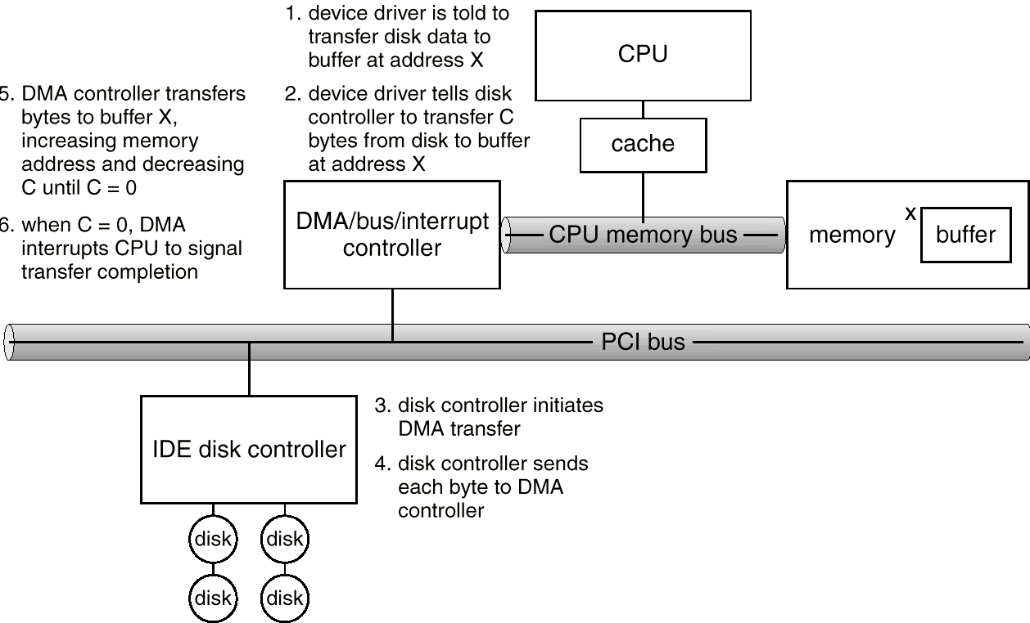
Six Step Process to Perform DMA Transfer

Slide 17
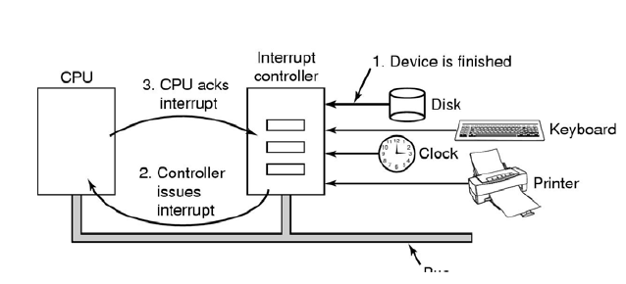
Interrupt I/O

Slide 18
END

